Slide 1
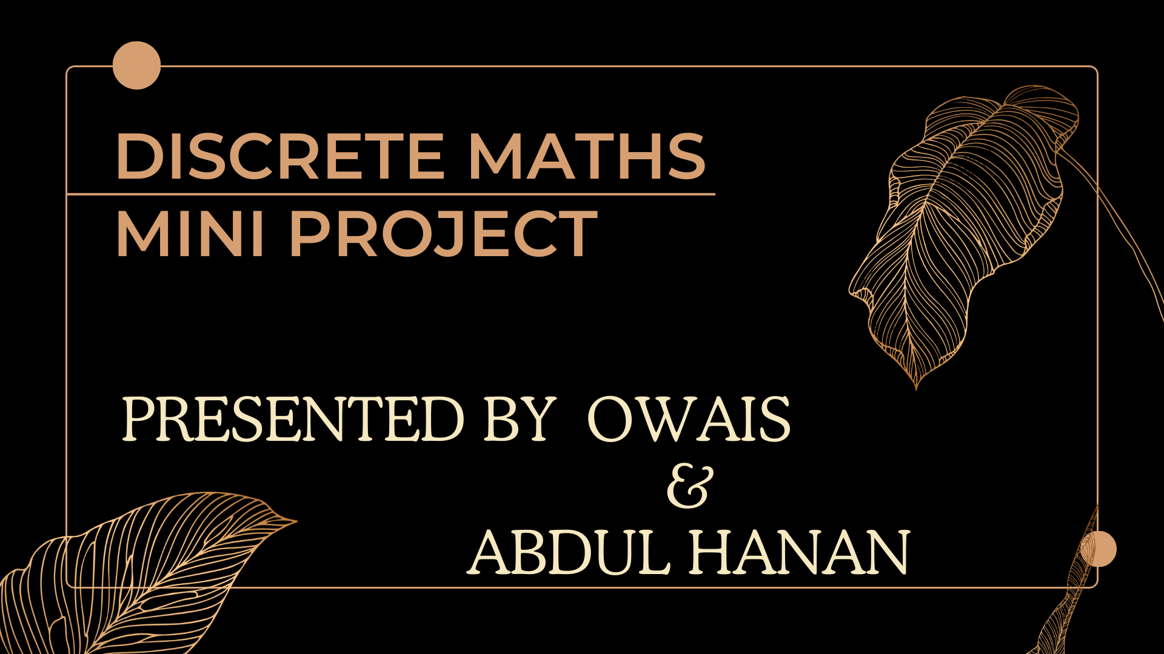
Presented By: Muhammad Owais & Abdul Hanan
Presented By: Abdul Hanan & Muhammad Owais

Slide 2


Slide 3


Slide 4
Individual Contribution & Project Planning
Individual Contribution
Project Planning
I successfully completed the project independently, thereby demonstrating my proficiency and unwavering commitment. This experience has not only honed my ability to excel as an individual contributor but has also fortified my capacity to achieve outstanding results in a team-oriented environment.
In project planning, I divided the project into 4 parts:
Number Theory
Graph Theory
Making PowerPoint
Making Documentation
I studied from different websites and seniors, and then, I implemented my knowledge to perform the tasks. I performed these tasks in C++.

Slide 5

Number Theory:
Number theory is a branch of mathematics that deals with the properties and relationships of whole numbers. It explores concepts like divisibility, primes, and modular arithmetic, with applications in cryptography and computer science.

Slide 6
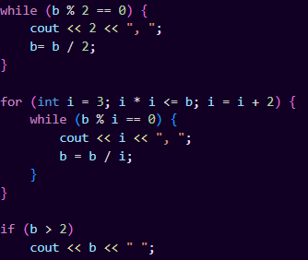

Coding Problems
Problem 1: Prime Factorization

Slide 7
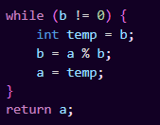

Coding Problems
Problem 2: GCD

Slide 8
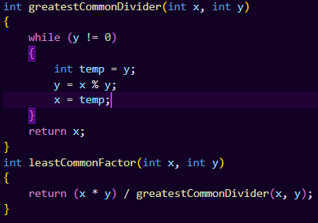

Coding Problems
Problem 3: LCM

Slide 9
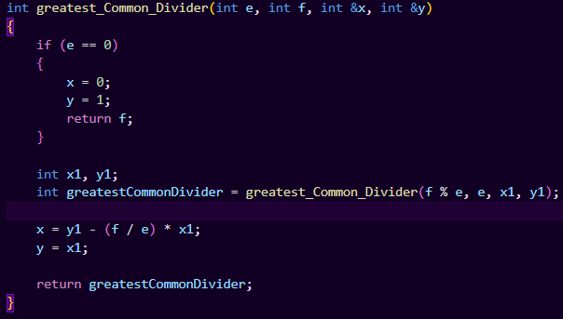

Coding Problems
Problem 4: Bezout Coefficients

Slide 10
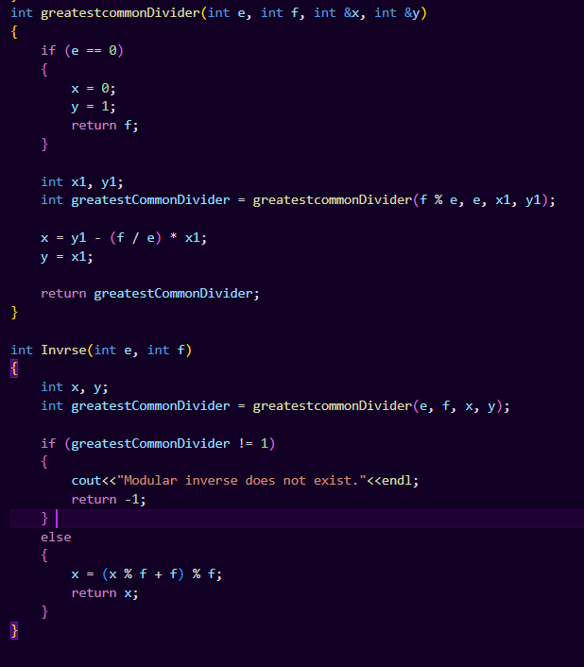

Coding Problems
Problem 5:Modular Inverse

Slide 11
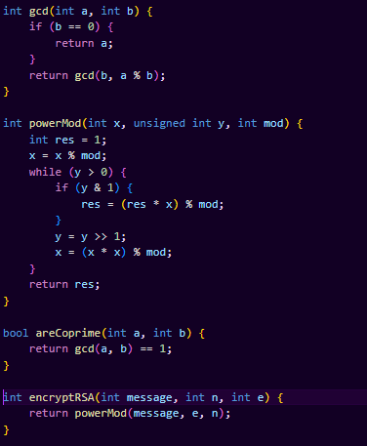
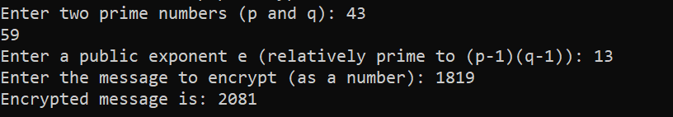
Coding Problems
Problem 6:Encryption

Slide 12
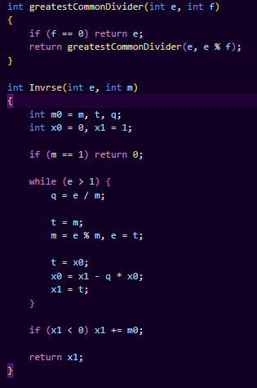

Coding Problems
Problem 7:Decryption

Slide 13

Conclusion:
In summary, number theory, a fundamental branch of mathematics, investigates the properties of integers and plays a crucial role in cryptography and computer science. Its exploration of prime numbers, divisibility, and modular arithmetic contributes to our understanding of mathematical structures.

Slide 14
Linkedin Video Link:
https://www.linkedin.com/posts/owais-khubaisi-2620b8290_our-project-represents-a-thrilling-exploration-activity-7147580487622967296-ZnYt/?utm_source=share&utm_medium=member_desktop

